Slide 1
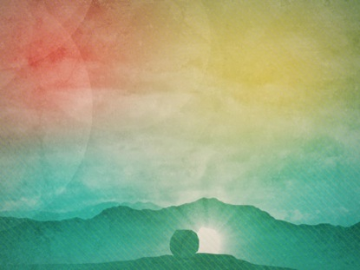
My Redeemer Lives

Slide 2
I know
He rescued my soul His blood covered my sin I believe, I believe

Slide 3
My shame
He's taken away My pain
is healed in His name I believe, I believe

Slide 4
I'll raise a banner
'Cause my Lord has conquered the grave

Slide 5
My Redeemer live,
my Redeemer lives.
My Redeemer live,
my Redeemer lives

Slide 6
You lift my burden
and I rise with You.
I'm dancing on this mountain top.
To see Your Kingdom come

